Slide 1

VoltDrive Motors Inc.
Afolabi Isiaka – Aspiring Associate FP&A
7/24/2025

Slide 2
Business Segmentation
Product:
On-Site EV diagnostics & Repair, Emergency Service
Channel: DTC
EV Owners, New EV Owners, Hybrid Vehicles
Geography:
US Based (CA, Florida, Texas, Washington, Colorado)
Business during winter due to battery issues;

Slide 3
assumptions For this business
5 % Incremental growth per annum in EV Market
Market Penetration of about 1%
Assumed User retention drops 10% every year
3% of New Customers Subscribe
Pricing Model
Plan A:
Price $267
70% Customer Base
Plan B
Price $315
20% Customer Base
Plan C
Price $400
10% Customer Base
Estimate Cost of Items i.e. Vans, Equipment, Insurance, Software etc.

Slide 4
Logistics & Operations Strategy
Sourcing
Negotiate Bulk Discounts, Collect and recondition replaced batteries,
Resell into secondary markets (e.g. home storage, microgrid).
Operations
Launch with 10 Techs
OPEX grows with EV Market
Field Service
Onsite Service check
Diagnostics & Performance Check ups
Invoice Updates via Technician Apps
high-EV-density zip codes (CA, NY, TX)
Strategic Add Ons
Bundle with free install of used batteries for home invaters
App to offer vehicle battery diagnostics.

Slide 5
Vehicle Registration by State (2023)

Slide 6
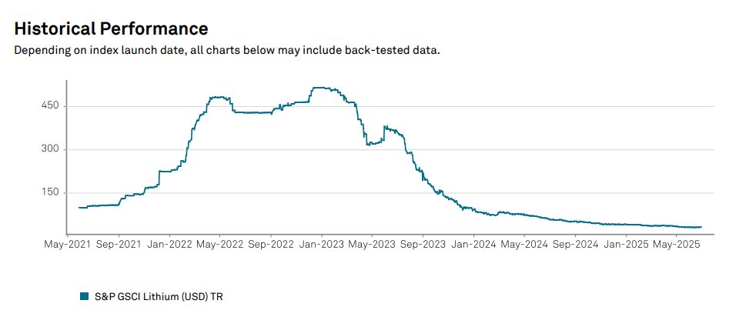
What is Going on in the Market?
U.S. EV Batteries prices are expected to fall by 50% in 2026 (Goldman Sachs)
Technological Innovation & Downturn in battery metal prices
Tariffs on China 30%
Street Case: EV Market is Bearish

Slide 7
Customer Segmentation
EV owners face uncertainty around battery longevity, resale value, and tech obsolescence.
Battery degradation averages 2.3%/year
Degradation is slower in newer EVs
Increased Degradation in hotter climates
Customers are tech-savvy, range-conscious, and willing to pay for future-proofing.

Slide 8
Market Competition

Slide 9
Implied Valuation
Date | Forecast | Lower Bound | Upper Bound
Q1 2026 | 2.9x | 0.7x | 5.1x
Q2 2026 | 2.9x | -0.2x | 6.0x
Q3 2026 | 2.9x | -0.9x | 6.7x
Q4 2026 | 2.9x | -1.5x | 7.3x
Calculated with an 85% Confidence Interval

Slide 10
Risk & Opportunties
Risk | Opportunities
Competitors Offer -- Warranty Service | Heated Weather in zip codes like TX or CA
Battery Supply Chain Volatility | Cross-Selling Solar Installations & Inverters
Technician Availability Bottleneck | Targeting fleet managers B2B
Technological Obsolescence Risk | Predictive Maintenance with User Data

Slide 11
Conclusion
Challenges
Bearish EV Market: A downturn in the EV industry may reduce investor appetite and limit funding opportunities
Startup Hurdles: VoltDrive Inc. is likely to face significant financial and operational challenges in the first few years of launch.
Opportunities
Stable Revenue Through Subscriptions: A subscription-based model offers recurring revenue and profitability, especially by targeting long-term battery maintenance needs.
Loyal Customer Base is Key: Success depends on building and retaining a consistent client base that sees value in preventative maintenance.

Slide 12
Sources
https://www.cnn.com/2025/07/18/business/ev-battery-raw-material-tariff
https://www.spglobal.com/spdji/en/indices/commodities/sp-gsci-lithium-index/#overview
https://www.kbb.com/car-news/report-19-of-new-cars-are-hybrid-or-electric/
https://www.goldmansachs.com/insights/articles/electric-vehicle-battery-prices-are-expected-to-fall-almost-50-percent-by-2025
https://afdc.energy.gov/data/10962
https://insideevs.com/news/720398/study-battery-replacement-rates-evs/#:~:text=Recurrent%20Auto%20has%20looked%20at,EVs%20had%20their%20batteries%20replaced
https://www.youtube.com/watch?v=54xL0JqFia8&list=PLI2s1d64OQgGThOqI_YnfuCXU-LTbFyJn&index=10
https://pmc.ncbi.nlm.nih.gov/articles/PMC9753165/

